Slide 1


North Western University
Course Tittle: Computer Networks Sessional
Course Code: CSE – 3304
December 24,2022
Introduction to computer network using NS2 based on the domain as www.Instagram.com

Slide 2



Team Name
NWU_INSTA
Details of the Team Members
Parag Biswas
ID: 20201138010
Department of CSE
North Western University
Swan Mollick
ID:20201147010
Department of CSE
North Western University
Afra Anika Urbee
ID:20201159010
Department of CSE
North Western University

Slide 3
Overview of the project:
Introduction to Zenmap.
Different host to domain.
Design network topology.
Prepare Excel sheet for network diagram.
Introduction to NS2.
Source code of NS2 based on network diagram.
Output topology of NS2.
Summarization of the designed network.
Conclusion.

Slide 4
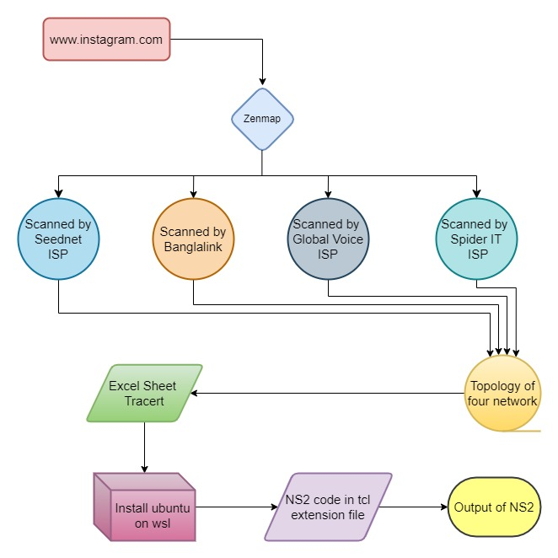
Birds Eye View of the project

Slide 5
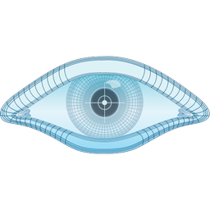
Introduction to Zenmap:
Zenmap is a small Open-source program based on the popular Nmap program. Zenmap offers a GUI which is preferred over the very outdated command line based Nmap. . It is a multi-platform , free and open source application which gives users a friendly interface. It has advanced features for experienced users.
Zenmap is available free from:
http://insecure.org

Slide 6
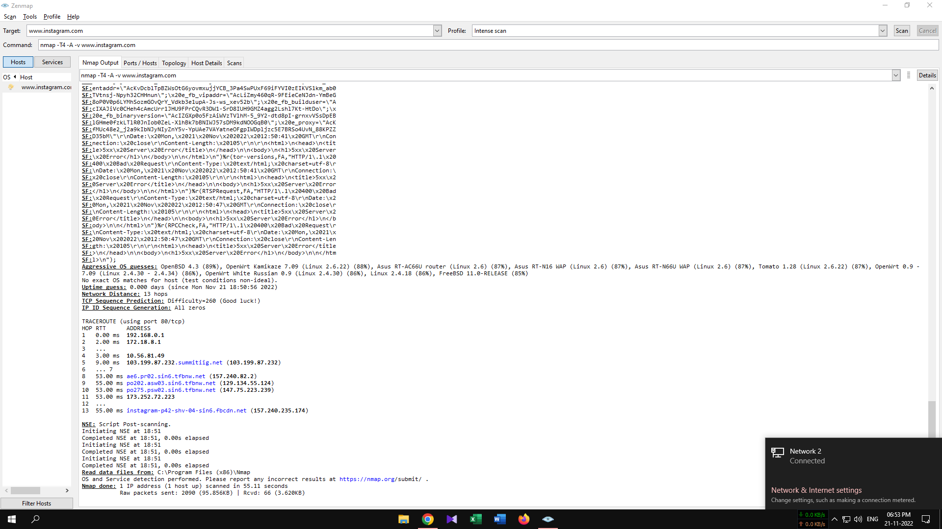
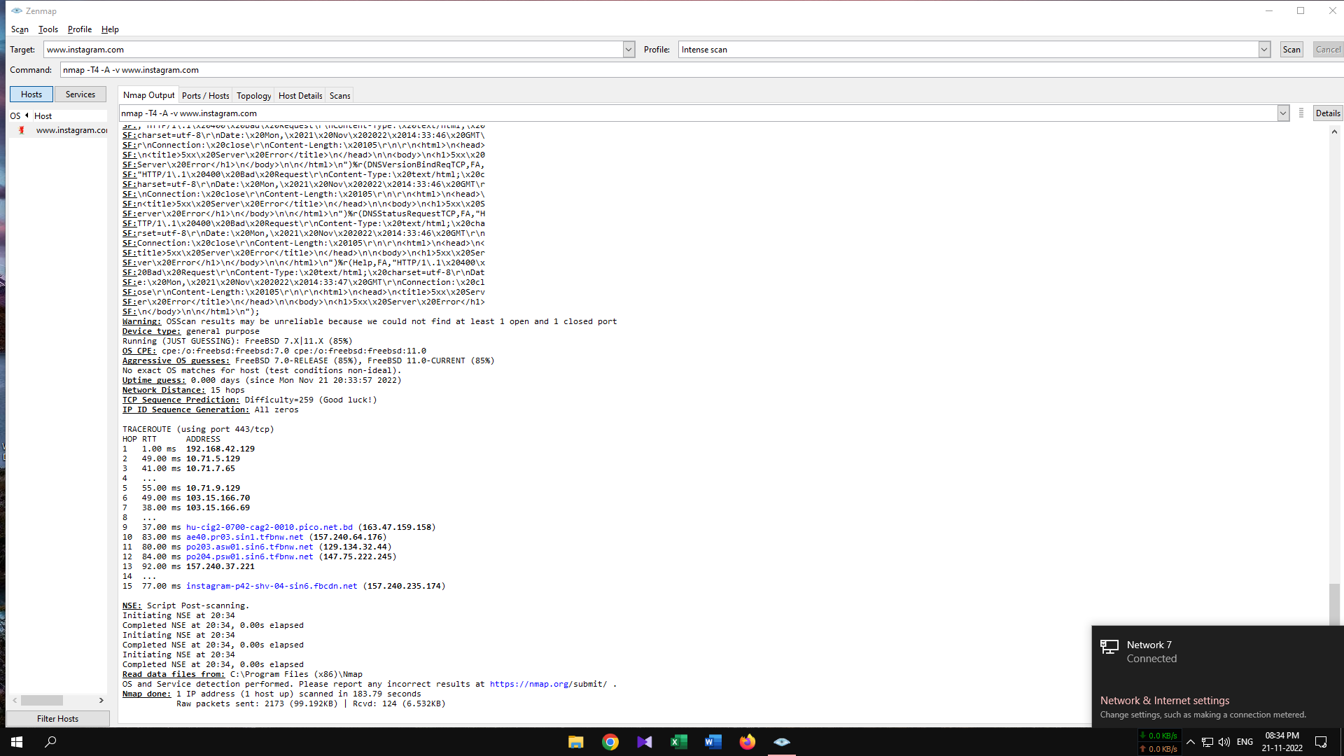
Different host to domain:
In this Project we scanned the website www.instagram.com with four different network to find the routing. We scanned the website with three WIFI network and one cellular network. The scan results of the four network is given below.
Speednet ISP network Zenmap scan result
Banglalink cellular Network Zenmap result

Slide 7
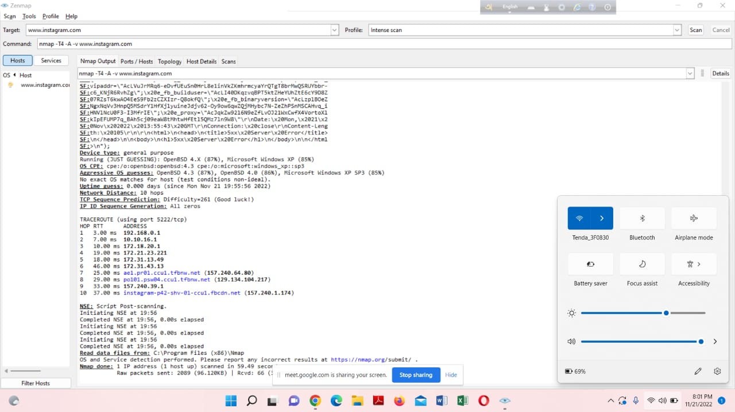
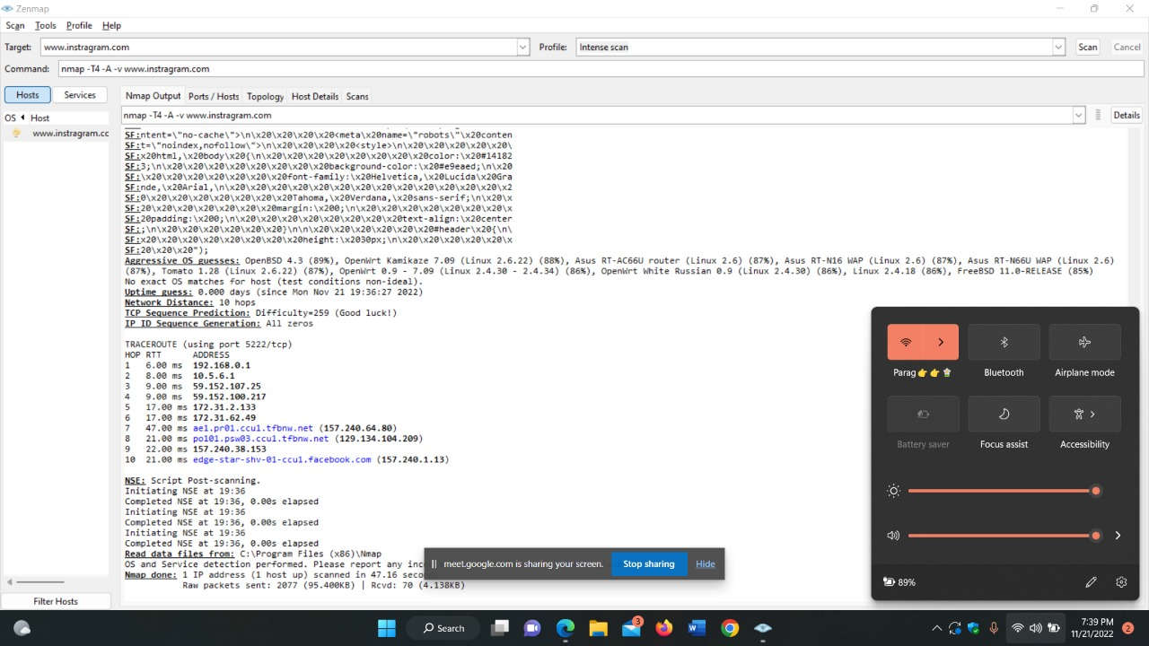
Global Voice ISP Zenmap scan result
Spider IT ISP Zenmap scan result

Slide 8
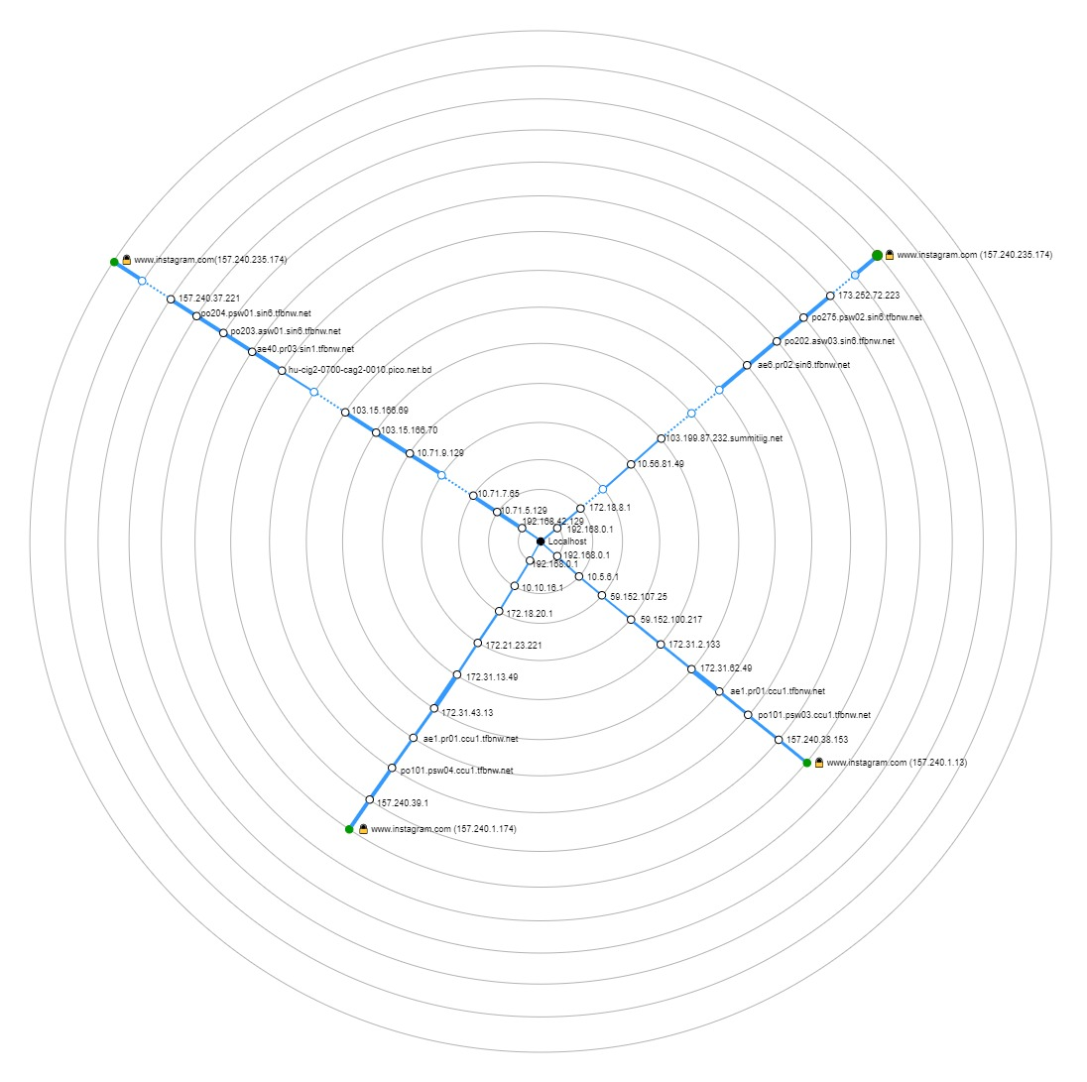
Design network topology:
Network topology is the arrangement of computers, network devices and other components of a network. It describes how various devices in a network are connected to one another and how they communicate. Network topology can be either physical or logical.
In this project our target IP is same but hosts IP is different. After scanning four network with Zenmap we find this network topology.

Slide 9
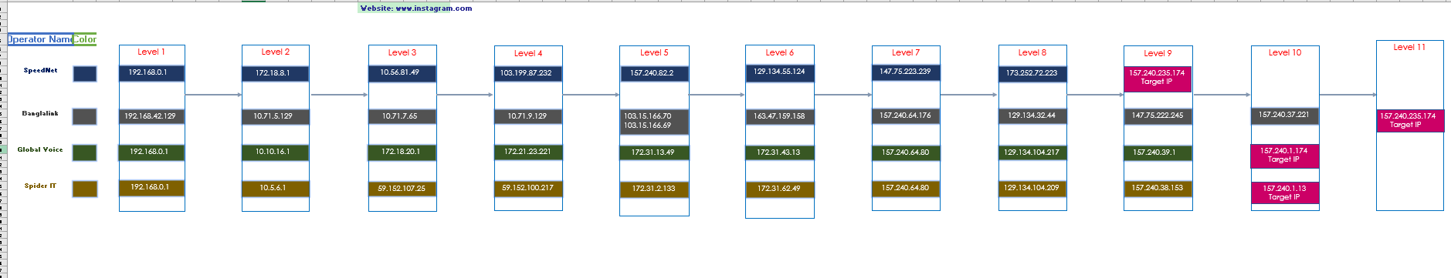
Prepare Excel sheet for network diagram:
After getting network topology from Zenmap, we have to create a excel sheet for network simulation.
This is our final excel sheet diagram for our project.

Slide 10
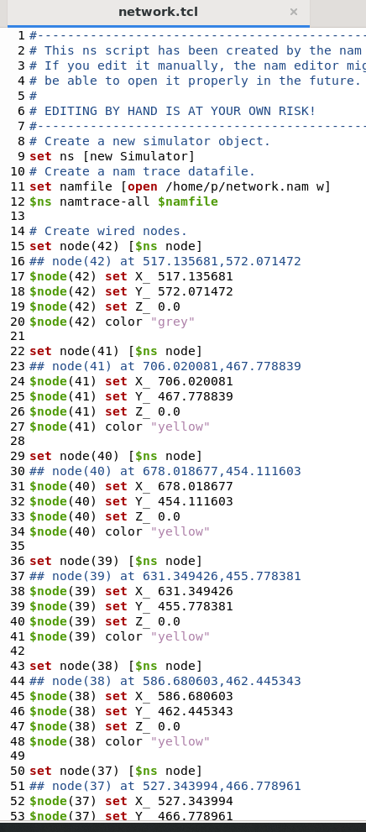
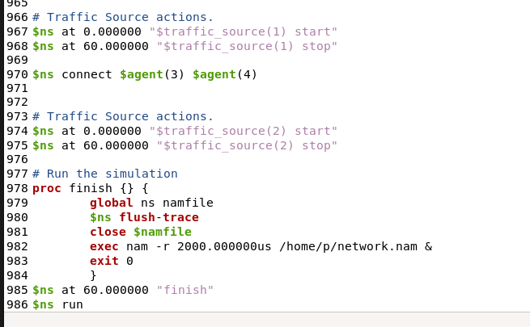
Introduction to NS2:
NS2 stands for Network Simulator Version 2. It is an open-source event-driven simulator designed specifically for research in computer communication networks.
In short, NS2 is used to Simulate network scenarios and analyze it's outcomes based on various network factors like packet loss, delay, error, intrusion, etc.
Source code of NS2 based on network diagram:
Full source code are available on the GitHub link-
https://github.com/cseku170202/Spring_20_CSE-3304-D-_NWU/tree/main/Group%207/Network%20Simulator%20Source%20Code

Slide 11
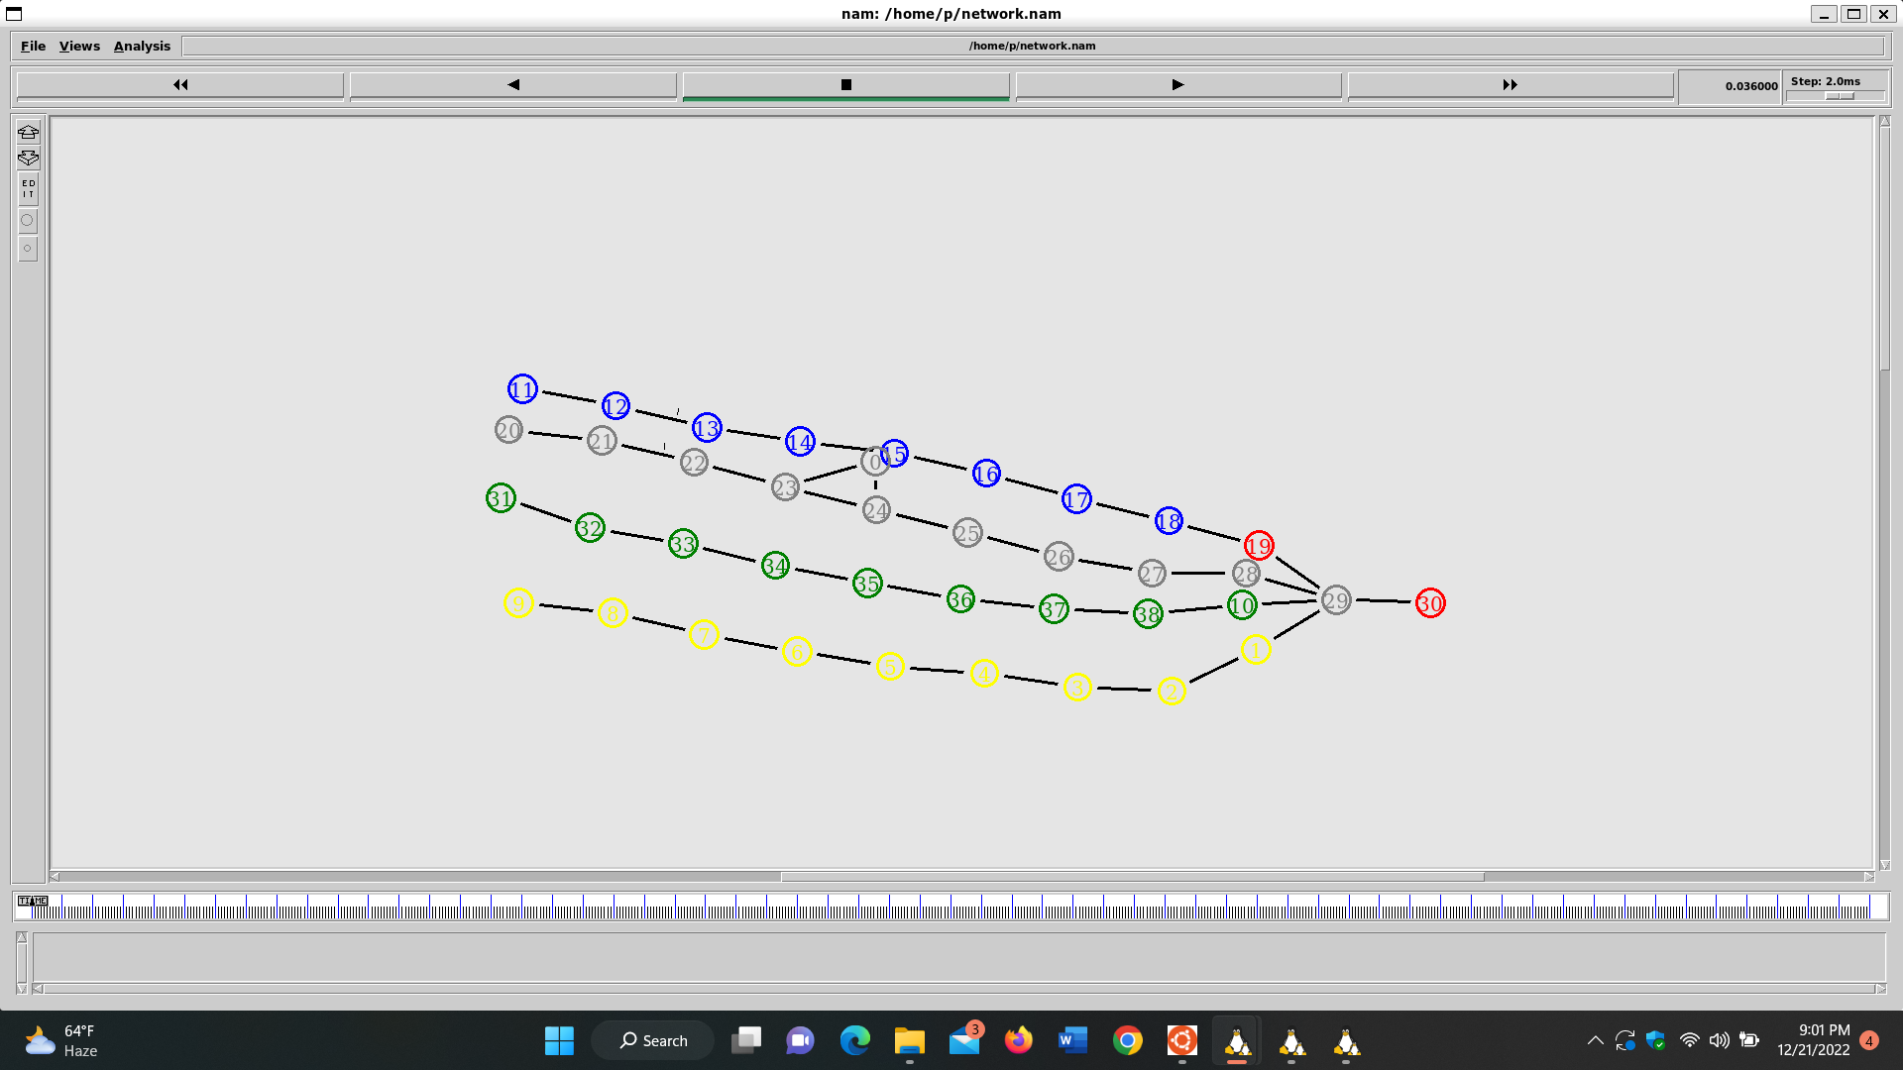
Output topology of NS2:
By using the executed command to go the simulation window and to get the simulation results successfully.
Here ,4 different types of IP-address are used to making this network simulator.
Bellow this figure, this is the starting point of network simulator.

Slide 12
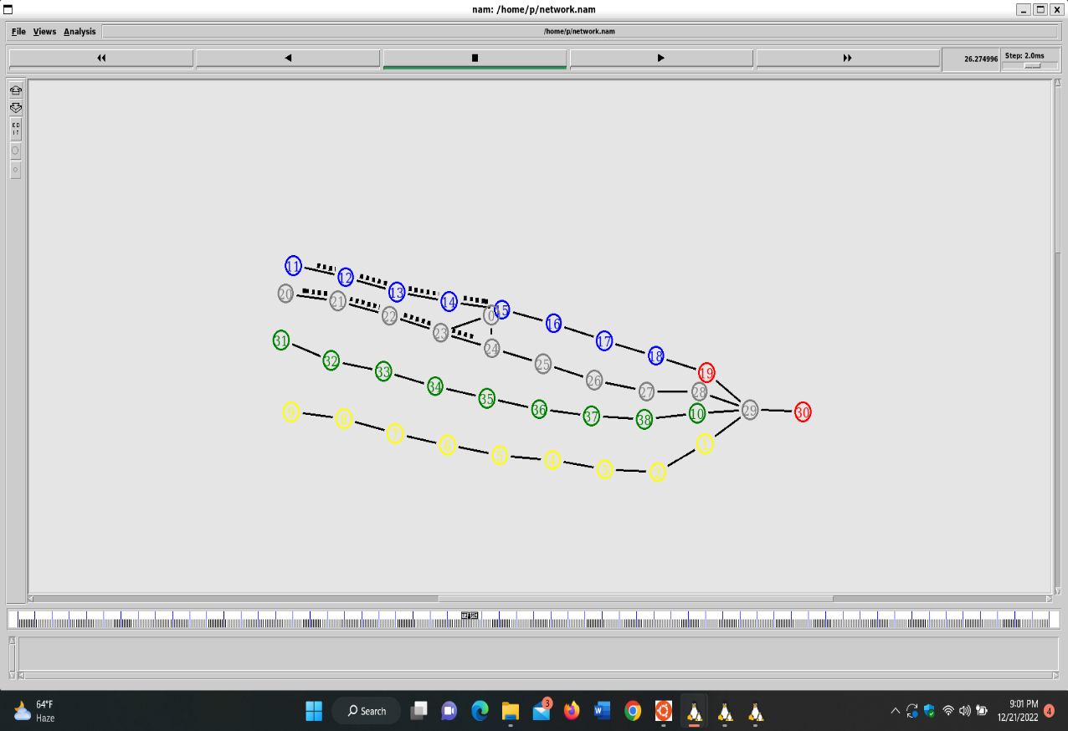
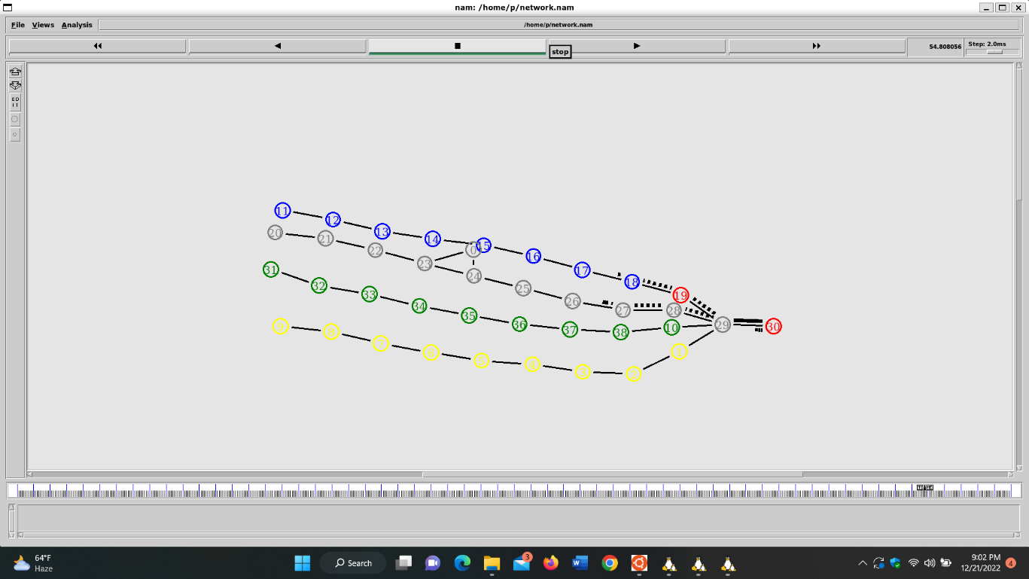
In this figure, it is shown the middle position of this network simulation. The simulations were going to the target IP-address by these nodes.
This is the last position of network simulations. The simulations were going to the target IP-address and want go back to the previous IP-address after reached the target IP-address/nodes.

Slide 13
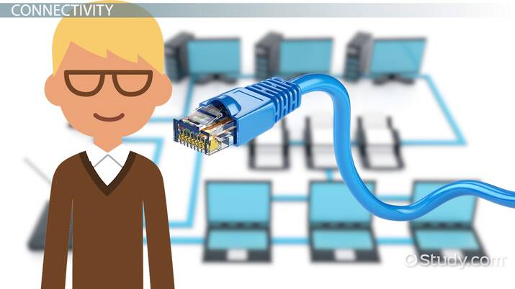
Summarization of the designed network:
Zenmap lets us create a topology map of discovered networks. It arranges its display to show all ports on a host or all hosts running a specific service.
After we scanned www.instagram.com using all 4 different networks we found our desired topology design.
After completing the scan and collecting all the IP addresses from the 4 different networks we stored them in a excel sheet named final excel sheet. Then we organized them into a excel tracert.
Then we used the source code and the IP addresses in NS2 software to and got the output.

Slide 14
Conclusion:
We first of all learnt a lot about NS2 and wireless scenarios in NS2 and it is also a good experience to work on ubuntu. The main learning of our projects the practical understanding of Networking Simulator.
The goal of NS2 is to support networking research and education. It is suitable for designing new protocols, comparing different protocols and traffic evaluations. NS2 is developed as a collaborative environment.

Slide 15


